Slide 1
Stock Prediction Model
Submitted in the partial fulfillment for the award of the degree of
BACHELOR OF ENGINEERING
IN
NAME_OF_SPECIALIZED_BRANCH
Submitted by:
Daksh Rawal(19BCS3849)
Aryan Gupta(19BCS3828)
Prajwal (19BCS3831)
Under the Supervision of:
Dr. Rahul Rastogi
Department of AIT-CSE
DISCOVER . LEARN . EMPOWER

Slide 2
Outline
Introduction to Project
Problem Formulation
Objectives of the work
Methodology used
Results and Outputs
Conclusion
Future Scope
References

Slide 3
What is Stock and Stock Market
A financial instrument that represents ownership in a company or corporation.
Representation of a proportionate claim on its assets and earnings.
Stocks are also called shares or equity.
Refers to the collection of exchanges and other venues where the buying, selling, and issuance of shares of publicly held companies take place.

Slide 4

Problem Formulation
Importance of a very precise prediction of a future trend.
Uncovering the market trends
Planning investment tactics
Identifying the best time to purchase the stocks and which stocks to purchase.
This Photo by Unknown Author is licensed under CC BY-NC

Slide 5

Objectives of the Work
Study about different methodology’s
Get a stock market prediction tool to obtain more accurate stock prediction price.
Evaluation of Stocks with some performance measures.
Reduction of error proportion in predicting the future stock prices.
This Photo by Unknown Author is licensed under CC BY-SA

Slide 6
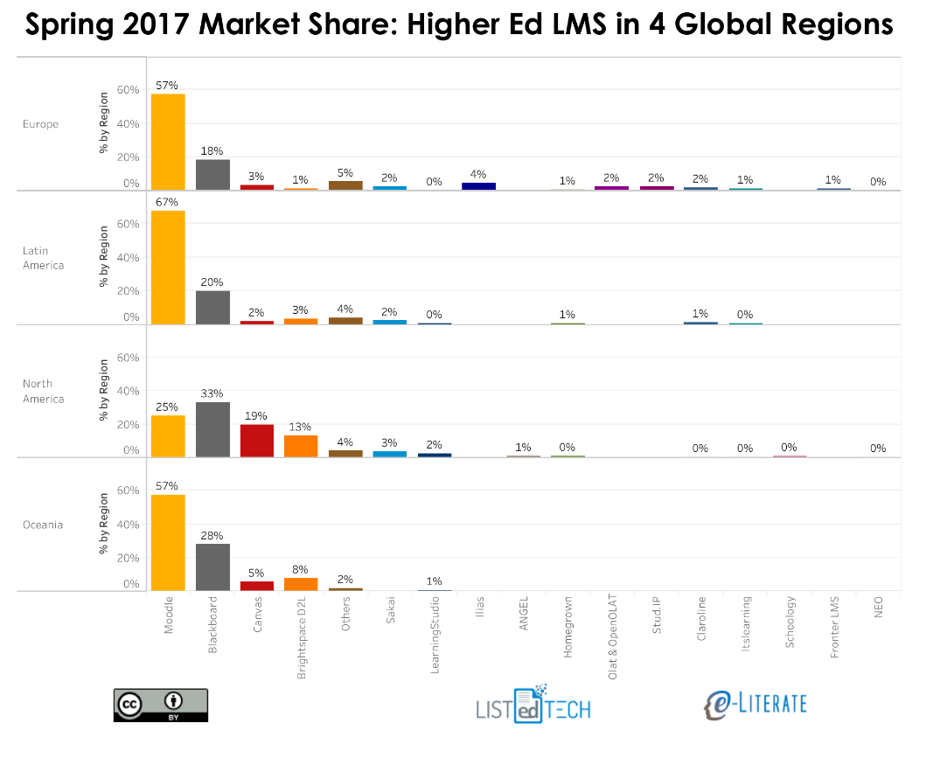
Existing System
Qualitative analysis
Quantitative analysis
Available Statistical models
Momentum
Mean Reversion
Martingales
The Search for Value
This Photo by Unknown Author is licensed under CC BY

Slide 7
Proposed System
Bench Mark Model
Long-Short Term Memory Model
Improved Long-Short Term Memory Model
The process of change of stock price indices based on technical analysis and provides assistance for financial specialists to choose the better timing for purchasing and selling stocks.
Development of prediction model is used for visualization of results

Slide 8
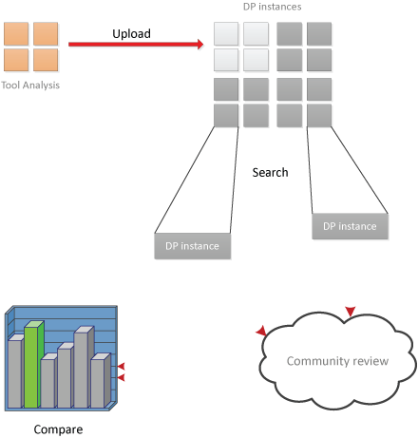
Bench Mark Model
Process of comparing your result to existing methods.
Aims to identify the most critical key performance indicators (KPIs)
Helps to define a consistent measurement process.
Process large amounts of data in the shortest time possible.
This Photo by Unknown Author is licensed under CC BY

Slide 9
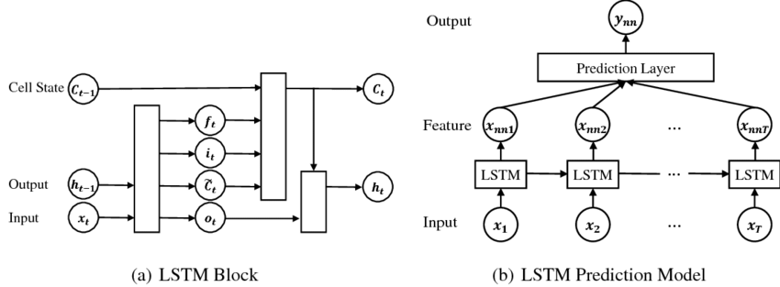
Long-Short Term Memory Model
An advanced RNN, a sequential network, that allows information to persist.
Capable of handling the vanishing gradient problem faced by RNN.
A recurrent neural network is also known as RNN is used for persistent memory.

Slide 10
Improved Long Short Term Memory Model
An improved model is proposed to solve the problems.
The input variables are divided into the delay variables and no-delay variables.
The delay variables participate in LSTM model calculate and generate the memory block output
The no-delay variables merge with to form new input.
Then, a feedforward neural network is established for the new input.

Slide 11
Methodology Used
Dataset
Preprocess the Data
Bench Mark Model
Long-Short Term Memory Model
Improved Long-Short Term Memory Model
Robustness of Improved Long-Short Term Memory Model

Slide 12
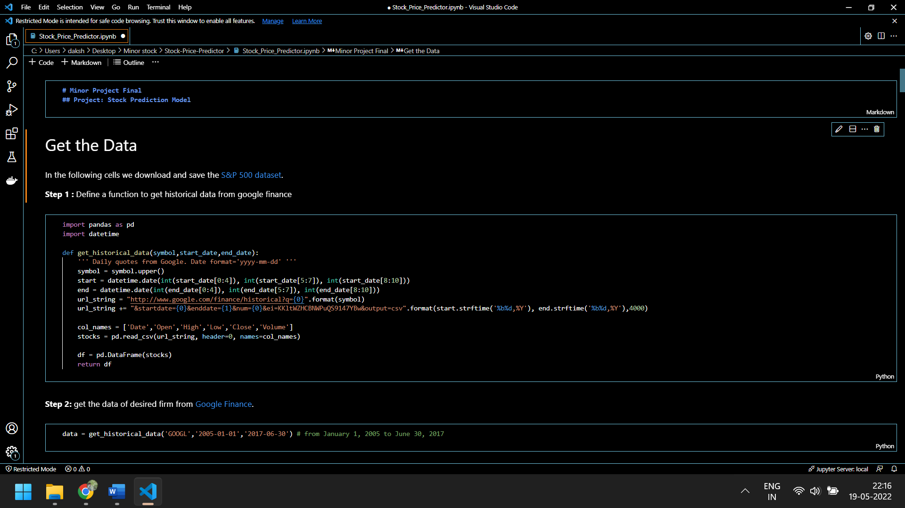
Results and Outputs
Getting The Data

Slide 13
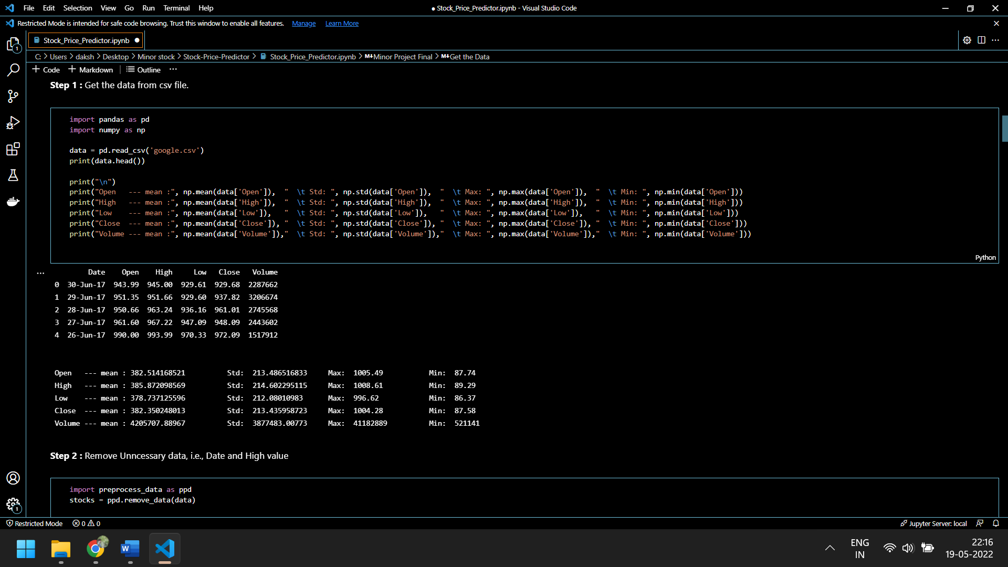
Data Pre-processing

Slide 14
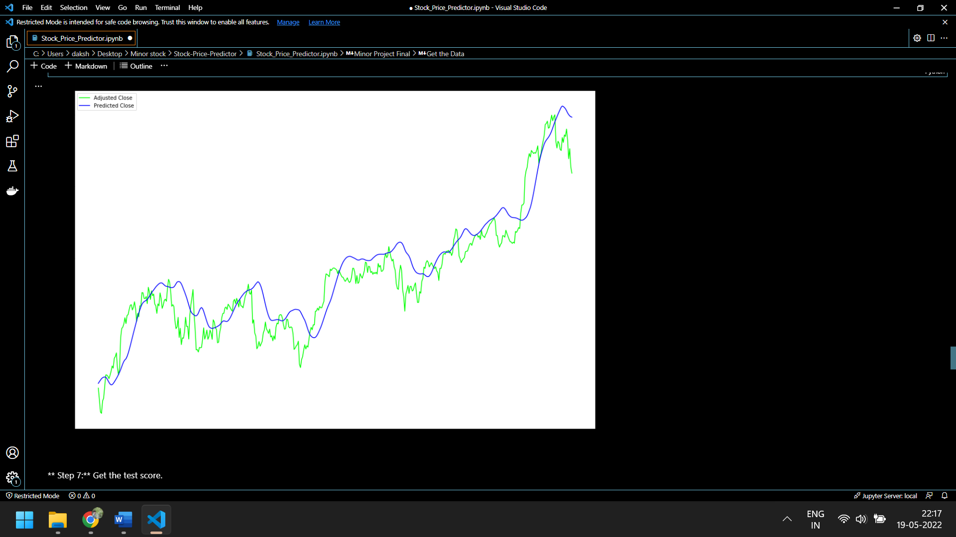
Visualizations

Slide 15
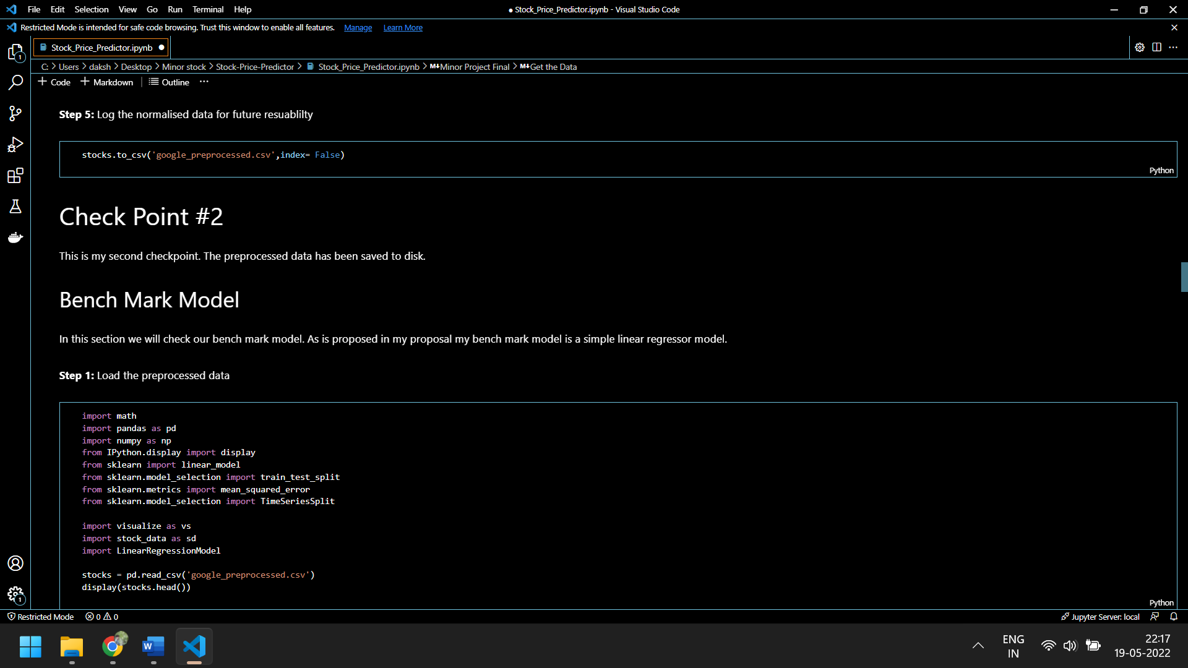
Bench Mark Model

Slide 16
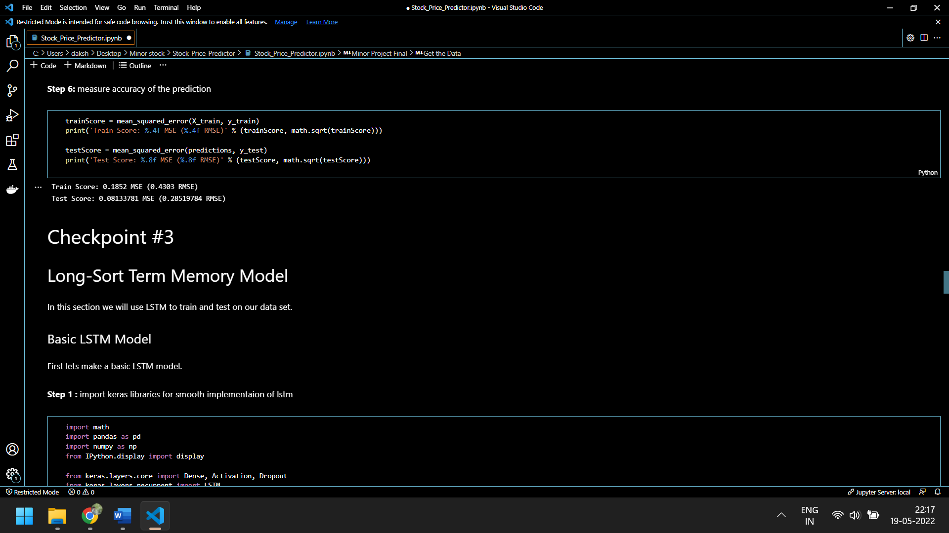
Long-Sort Term Memory Model

Slide 17
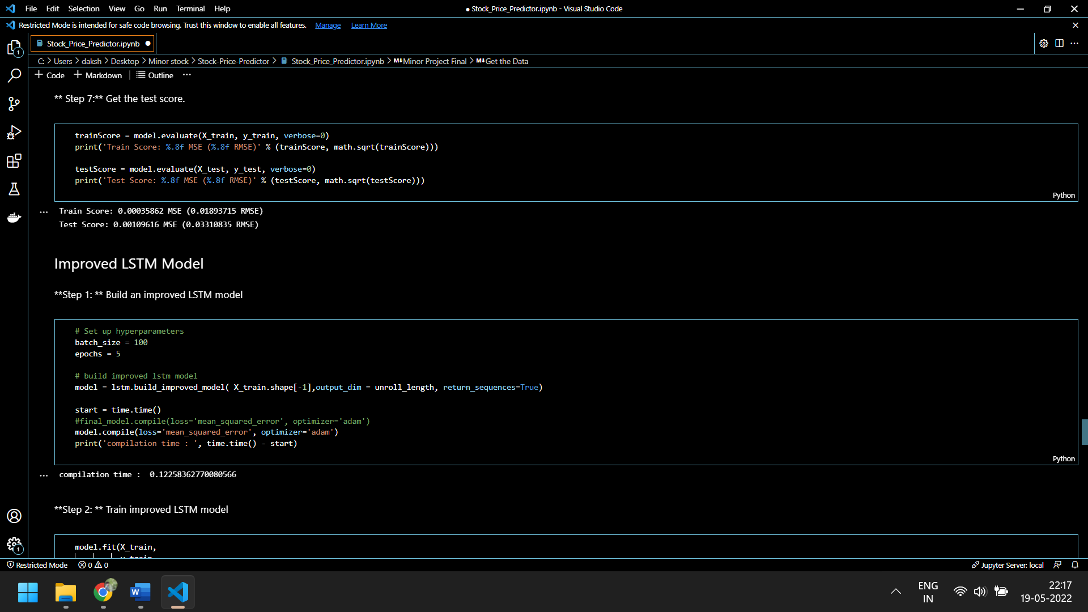
Improved LSTM Model

Slide 18
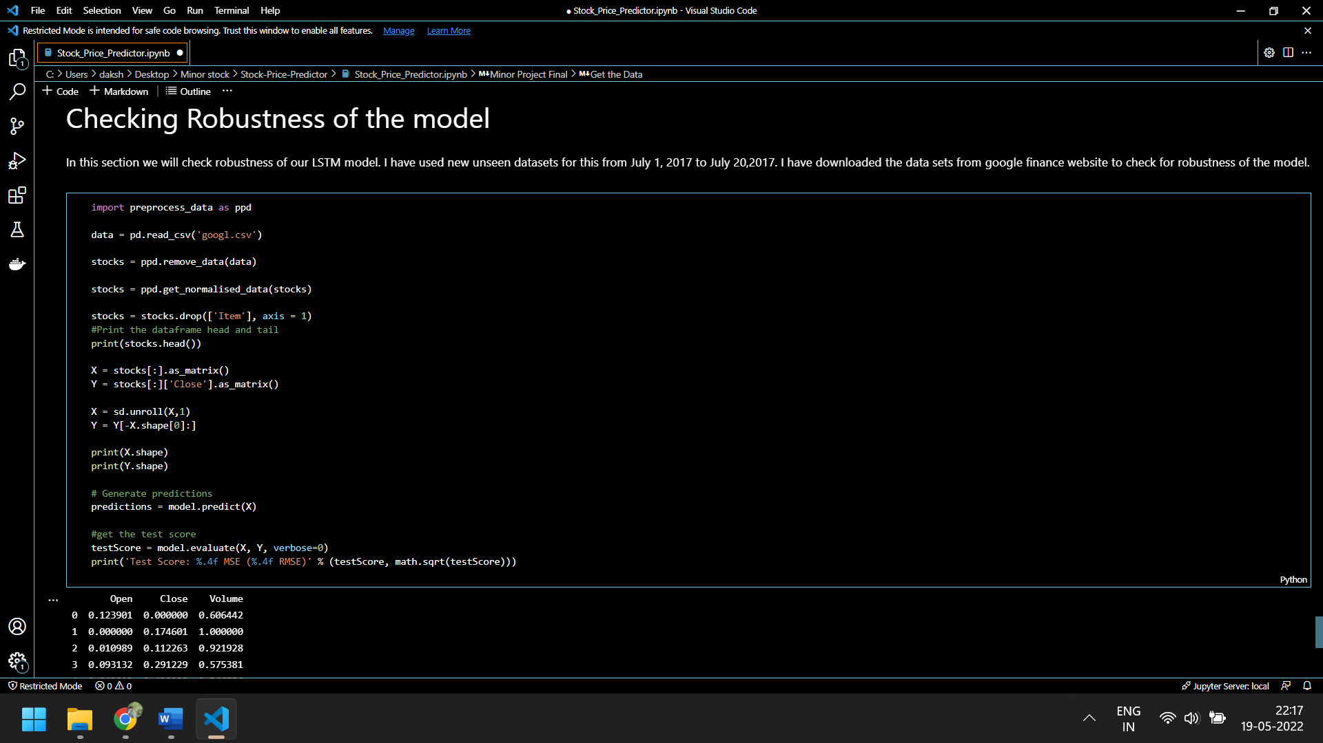
Robustness Check

Slide 19

Conclusion
Studied different methodologies for Stock Market Prediction
Implementation of Bench Mark Model
Implementation of Long-Sort Term Memory Model
Implementation of Improved Long-Sort Term Memory Model
This Photo by Unknown Author is licensed under CC BY-NC

Slide 20
Future Scope
Interactive GUI using Django or Streamlit.
Working with Multiple Datasets
Working with Real time Data
Web-Based Application
To perform efficiently in short amount of time

Slide 21
References
Stock Price Prediction Using LSTM on Indian Share Market by Achyut Ghosh, Soumik Bose1, GiridharMaji, Narayan C. Debnath, Soumya Sen
S. Selvin, R. Vinayakumar, E. A. Gopalkrishnan, V. K. Menon and K. P. Soman - Stock price predictionusing LSTM, RNN and CNN-sliding window model - 2017.
Murtaza Roondiwala, Harshal Patel, Shraddha Varma, “Predicting Stock Prices Using LSTM” in Undergraduate Engineering Students, Department of Information Technology, Mumbai University, 2015.
Xiongwen Pang, Yanqiang Zhou, Pan Wang, Weiwei Lin, “An innovative neural network approach for stock market prediction”, 2018

